Slide 1


DATATECH LABS.
Data Engineering Course.
Week 5: Data Automation, Orchestration and Visualization

Slide 2
Outline: Week 5
Introduction to Data Pipeline Automation and Orchestration
Benefits and Challenges of Pipeline Automation
Apache Airflow as Automation and Orchestration Tool
Data Visualization and Reporting
Data Visualization Principles and Reporting Tools
DATATECH LABS.

Slide 3
Data Pipelines Automation and Orchestration
DATATECH LABS.

Slide 4
Introduction to Data Pipeline Automation and Orchestration
DATATECH LABS.

Slide 5
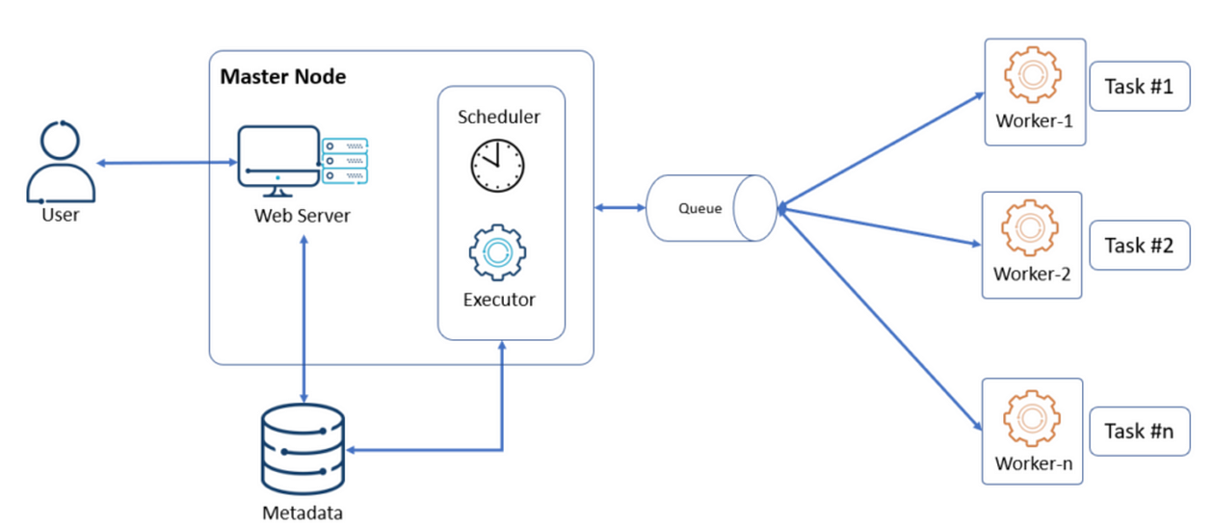
Introduction to Automation and Orchestration
Definition: The process of automating and managing complex data workflows
Automation is programming a task to be executed without the need for human intervention.
Orchestration is the configuration of multiple tasks (some may be automated) into one complete end-to-end process or job.
Faster and More Effective Insights for
modern data architectures
DATATECH LABS.

Slide 6
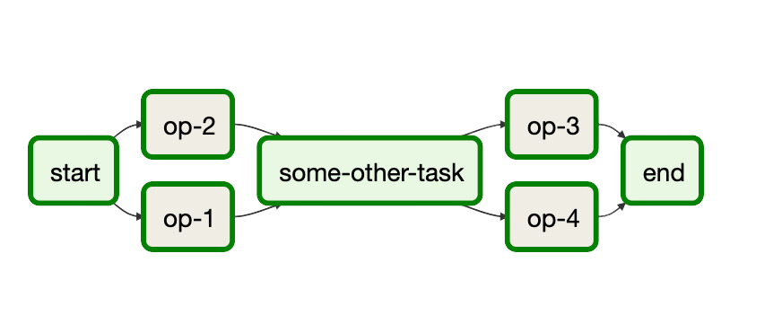
Key Concepts in Pipeline Automation
Workflow: A series of tasks that process data
Task: An individual unit of work
Dependency: The relationship between tasks
Scheduling: Timing and frequency of workflow execution
Monitoring: Tracking the status and performance of workflows
DATATECH LABS.

Slide 7

Benefits of Pipeline Automation
Improved efficiency and reliability
Reduced manual errors
Better resource utilization
Enhanced scalability
Easier maintenance and troubleshooting
DATATECH LABS.

Slide 8

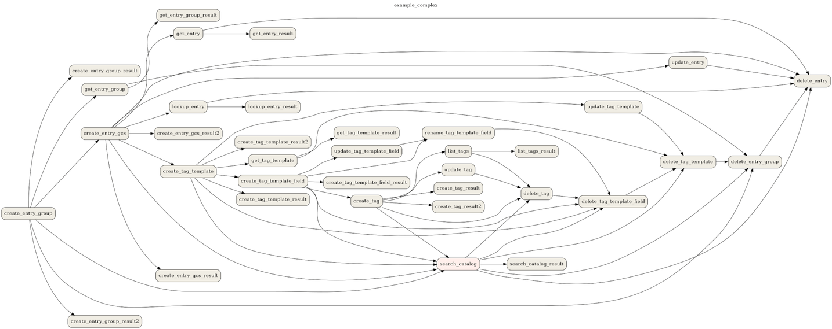
Common Challenges in Data Pipeline Management
Complex dependencies between tasks
Error handling and recovery
Data quality assurance
Performance optimization
Versioning and reproducibility
DATATECH LABS.

Slide 9




Pipeline Orchestration Tools Landscape
Apache Airflow
Luigi
Airbyte
Dagster
Argo Workflows
DATATECH LABS.

Slide 10
Apache Airflow as Automation Tool
DATATECH LABS.

Slide 11
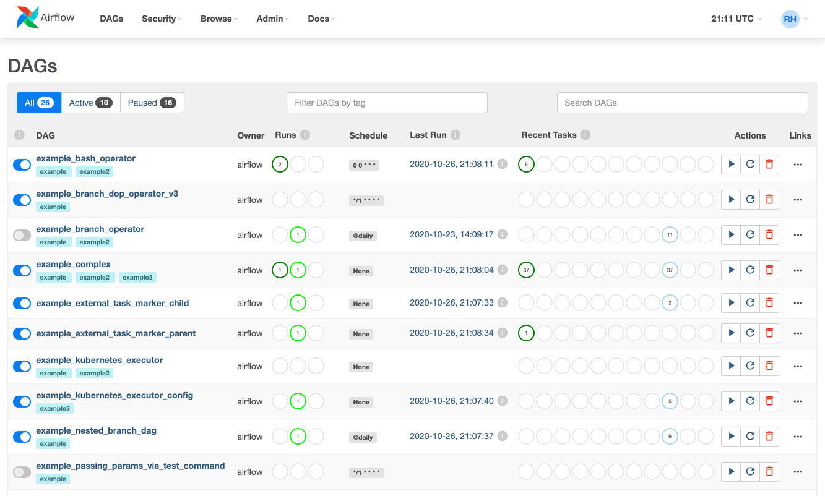
Introduction to Apache Airflow
Definition: An open-source platform to programmatically author, schedule, and monitor workflows
Created by Airbnb in 2014, now an Apache Software Foundation project
DATATECH LABS.

Slide 12
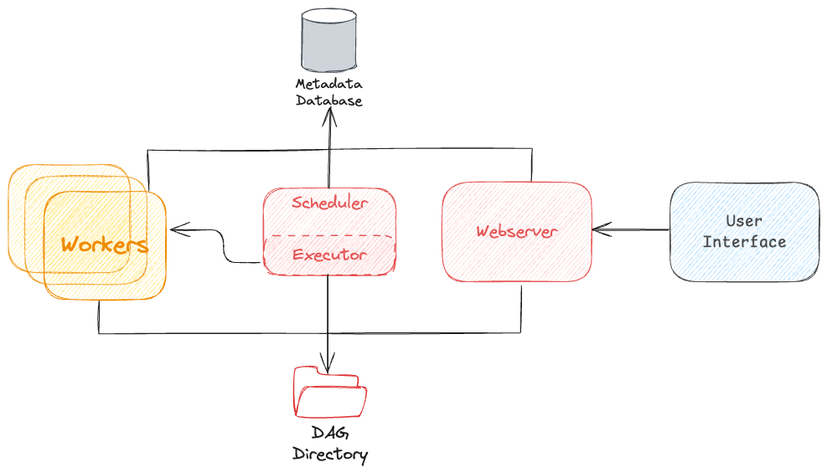
Airflow Architecture
Webserver: Provides the user interface
Scheduler: Monitors and triggers tasks
Workers: Execute the tasks
Metadata Database: Stores DAGs, task instances, and configurations
DAG Files: Python files defining the workflows
DATATECH LABS.

Slide 13
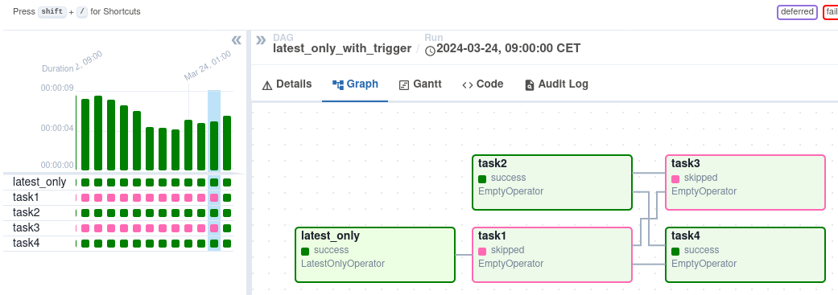
Key Concepts in Airflow
DAG (Directed Acyclic Graph): Represents a workflow
Operator: Defines a single task in the workflow
Task: An instance of an operator
Task Instance: A specific run of a task
Execution Date: The logical date and time of a DAG run
DATATECH LABS.

Slide 14
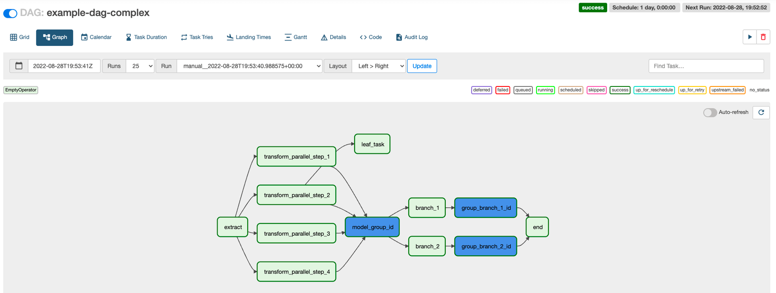
Airflow DAGs
Definition: A collection of tasks with dependencies
Properties:
DAG ID
Description
Start date
Schedule interval
Default arguments
DATATECH LABS.

Slide 15
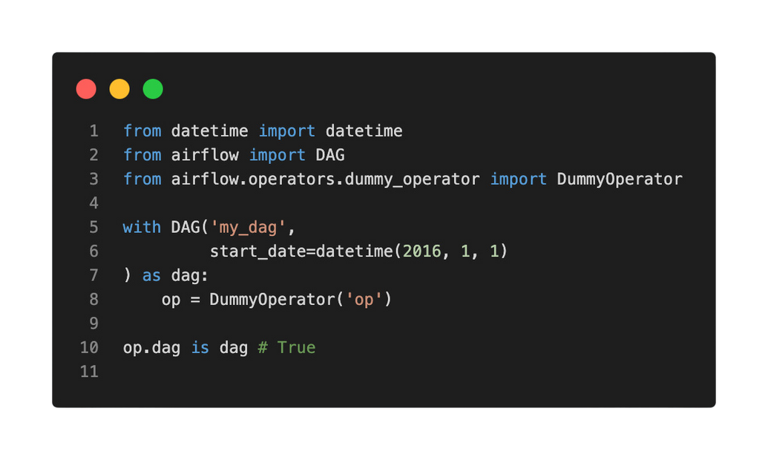
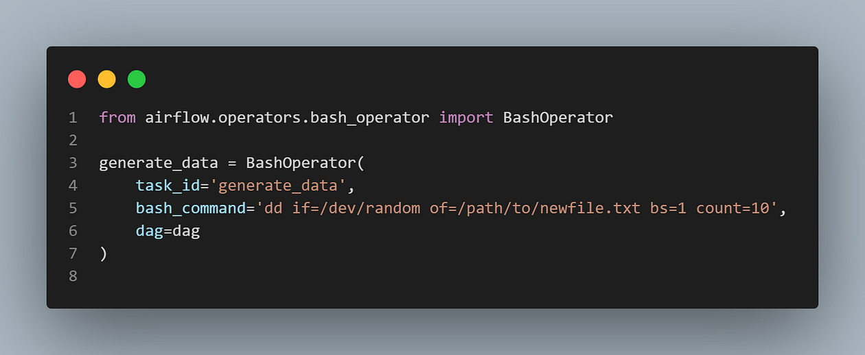
Airflow Operators
BashOperator: Executes bash commands
PythonOperator: Calls Python functions
SQLOperator: Executes SQL queries
EmailOperator: Sends emails
Custom operators: Extend functionality
for specific use cases
DATATECH LABS.

Slide 16
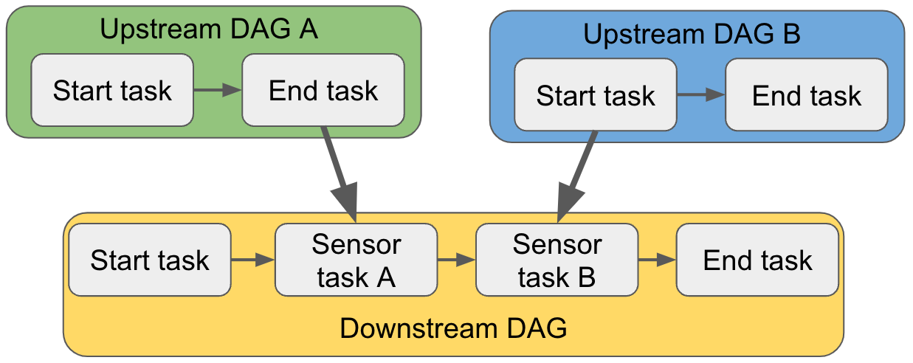
Task Dependencies in Airflow
Methods to set dependencies:
set_upstream() and set_downstream()
and << operators
Branching: Conditional execution of tasks
Trigger rules: Specify when a task should be executed
DATATECH LABS.

Slide 17
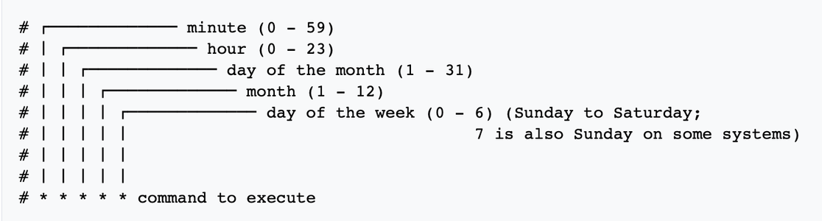
Airflow Scheduling
Cron expressions
Timedelta objects
External triggers
Backfilling: Running DAGs for past dates
DATATECH LABS.

Slide 18
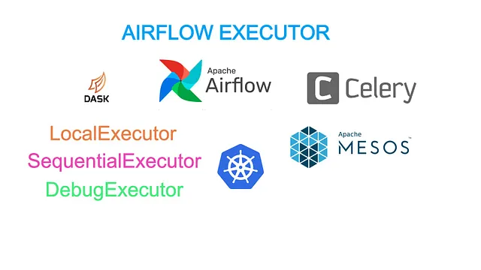
Airflow Executors
Executor is a mechanism that gets tasks executed.
it acts as a middle man to handle resource utilization and how to distribute work best.
Executors types:
Sequential Executor: Default, runs one task at a time
Local Executor: Runs tasks in parallel on a single machine
Celery Executor: Distributed execution across multiple workers
Kubernetes Executor: Dynamically launches tasks as Kubernetes pods
DATATECH LABS.
Notes:
https://towardsdatascience.com/a-gentle-introduction-to-understand-airflow-executor-b4f2fee211b1

Slide 19
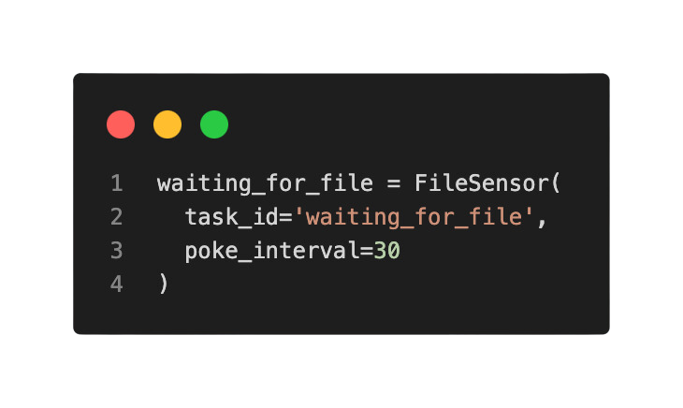
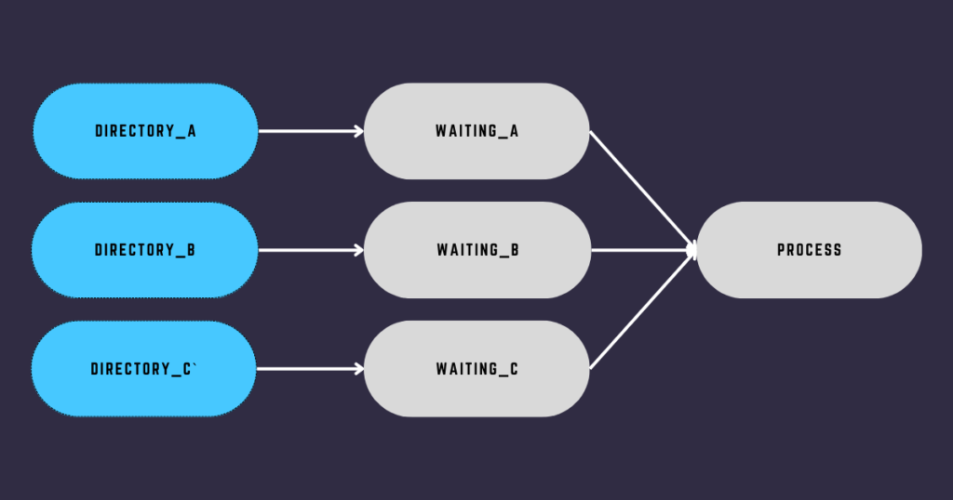
Airflow Sensors
Definition: Special operators that wait for a certain condition to be true
Types:
FileSensor: Wait for a file to land
ExternalTaskSensor: Wait for another DAG to complete
SqlSensor: Wait for a SQL query to return results
Custom sensors
DATATECH LABS.

Slide 20
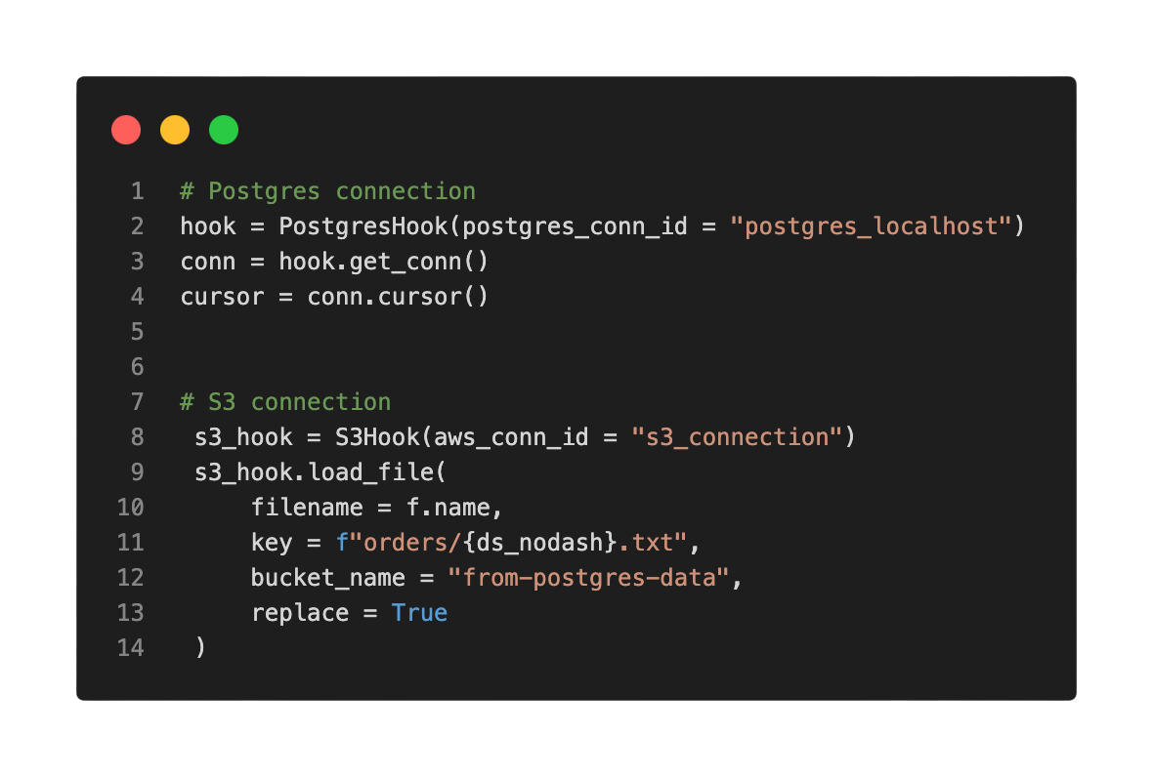
Airflow Hooks
Purpose: Interface to external systems and databases
Common hooks:
PostgresHook
S3Hook
HttpHook
Custom hooks
DATATECH LABS.

Slide 21
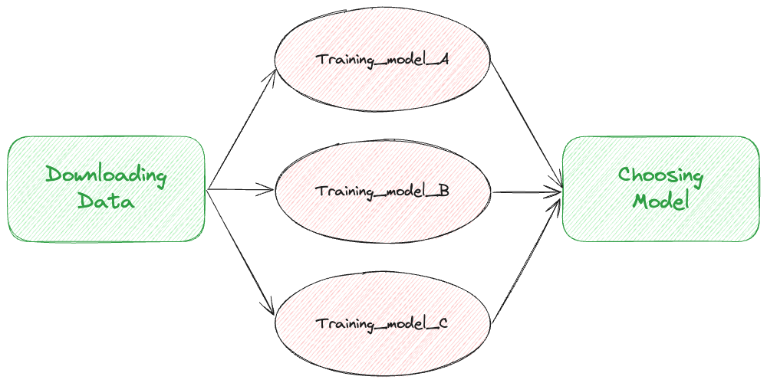
Airflow XComs (Cross-communication)
Purpose: Allow tasks to exchange small amounts of data
Methods:
xcom_push(): Store data
xcom_pull(): Retrieve data
Use cases and limitations
DATATECH LABS.

Slide 22
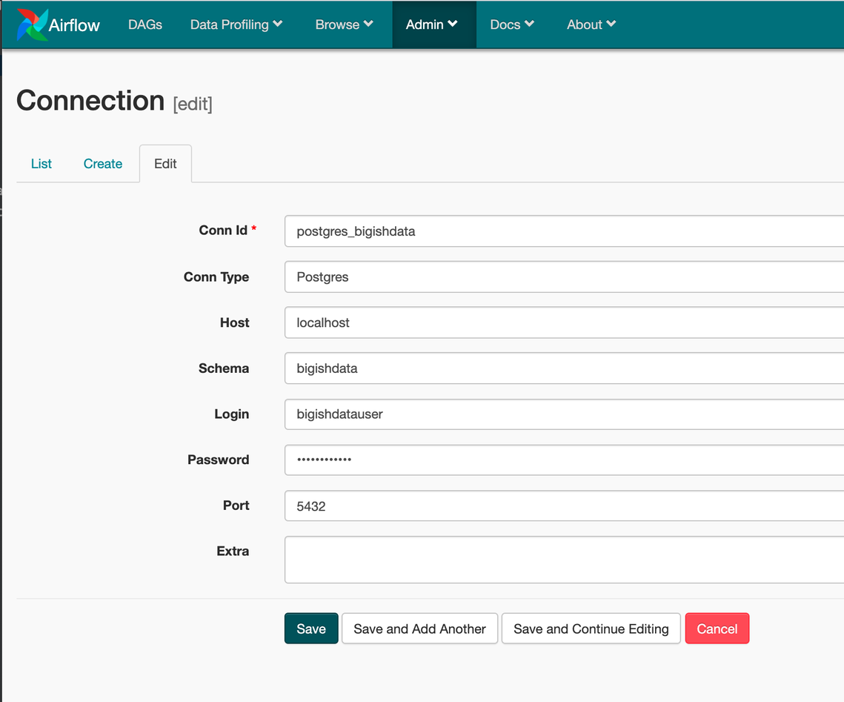
Airflow Variables and Connections
Variables: Key-value store for configuration
Connections: Store credentials and connection information
Accessing variables and connections in DAGs
DATATECH LABS.

Slide 23
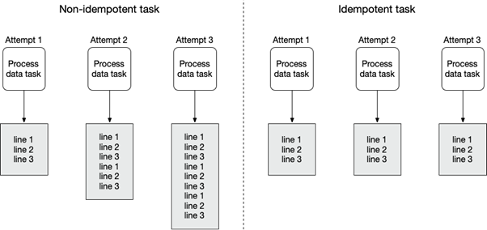
Airflow Best Practices
Keep tasks idempotent
Use templates for reusability
Implement proper error handling
Use pools for resource management
Leverage tags for organization
DATATECH LABS.

Slide 24
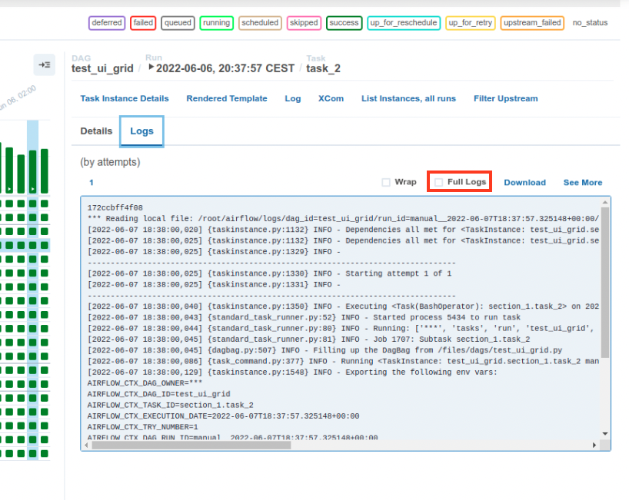
Airflow Monitoring and Logging
Web UI for monitoring DAGs and tasks
Logging configuration
Alerting and notifications
Integration with monitoring tools (e.g., Prometheus, Grafana)
DATATECH LABS.

Slide 25
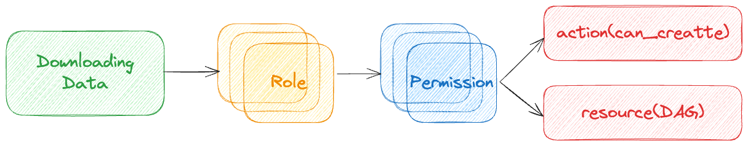
Airflow Security
Role-Based Access Control (RBAC)
Securing connections and variables
Encryption of sensitive information
Authentication methods
DATATECH LABS.

Slide 26
Hands-on:
Apache Airflow for Automation and Orchestration
DATATECH LABS.

Slide 27
Q&A and Discussion
DATATECH LABS.

Slide 28
Data Visualization and Reporting
DATATECH LABS.

Slide 29

Introduction to Data Visualization and Reporting
Definition: The graphical representation of data and information
Importance in data analysis and decision-making:
Allows business users to gain insight into their vast amounts of data.
Analyzing the Data in a Better Way
Faster Decision Making
Making Sense of Complicated Data
DATATECH LABS.

Slide 30
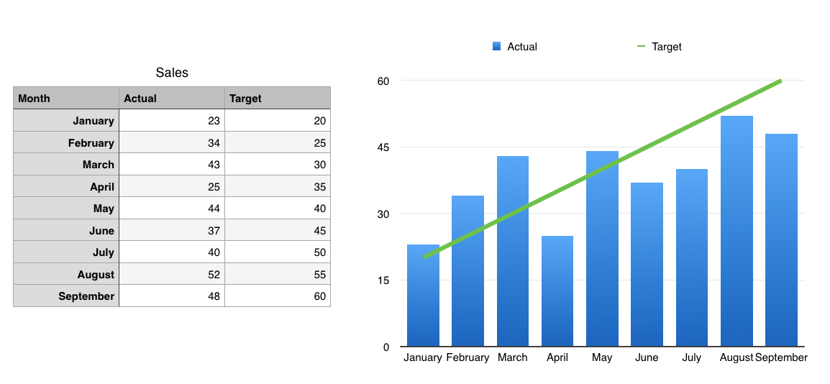
The Power of Data Visualization
Simplifies complex information
Identifies patterns and trends
Facilitates decision-making
Enhances data storytelling
Simplification of complex information
DATATECH LABS.

Slide 31
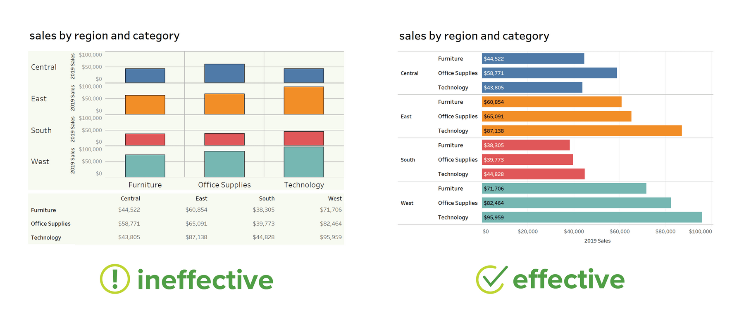
Data Visualization Principles
Clarity: Make the data easy to understand
Efficiency: Maximize data-ink ratio
Integrity: Represent data accurately
Aesthetics: Create visually appealing graphics
DATATECH LABS.

Slide 32
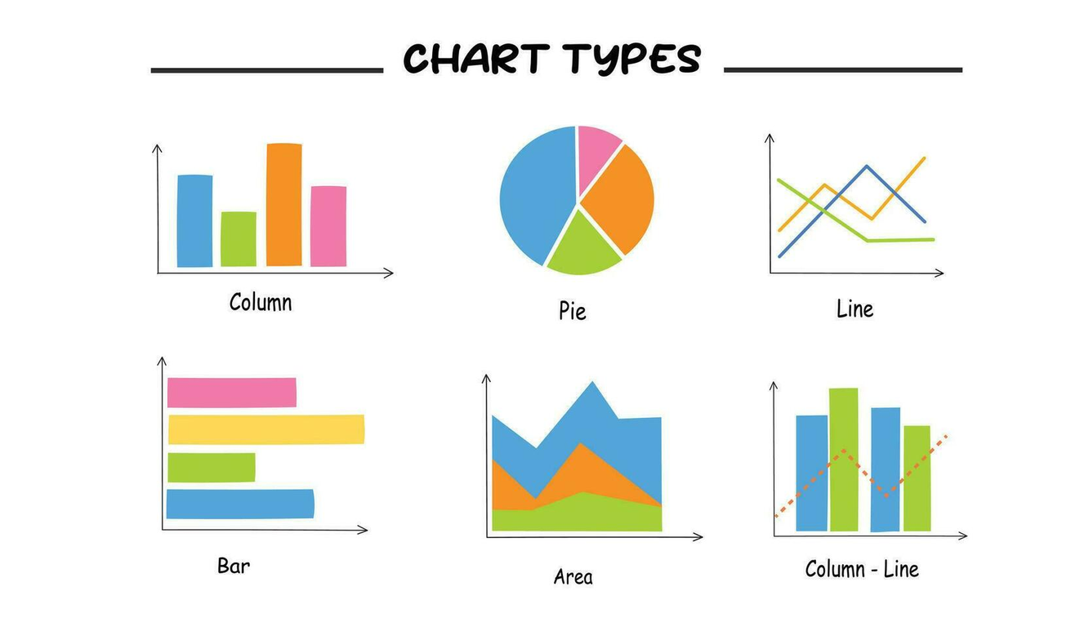
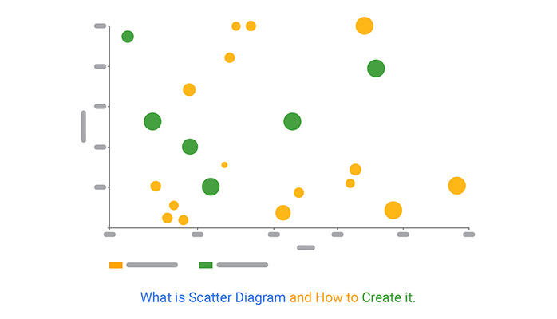
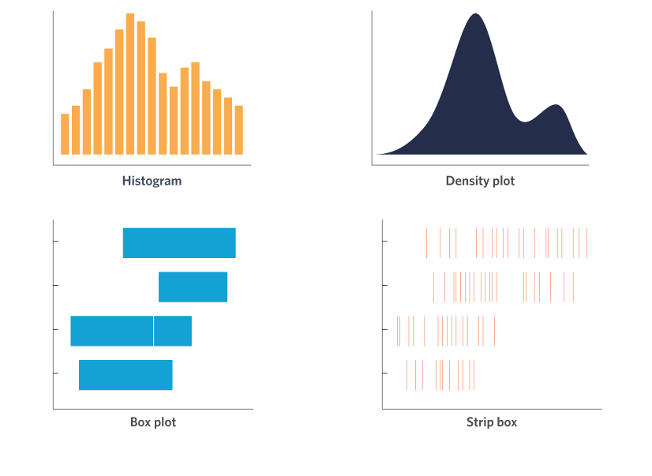
Common Chart Types
Bar charts: Comparing categories
Line charts: Showing trends over time
Scatter plots: Showing relationships between variables
Pie charts: Showing composition (use sparingly)
Histograms: Showing distribution of data
DATATECH LABS.
Scatter plots

Slide 33
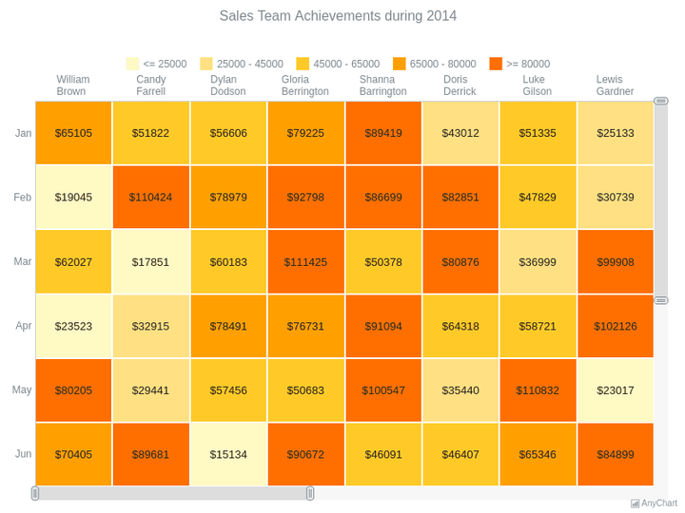
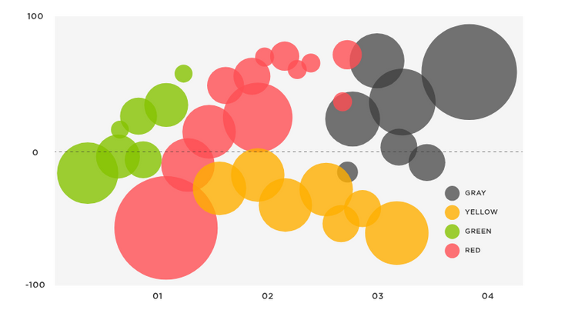
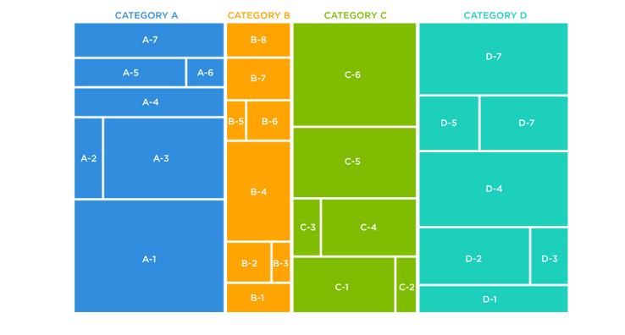
Advanced Chart Types
Heatmaps: Showing patterns in a matrix
Tree maps: Hierarchical data
Bubble charts: Comparing three variables
Sankey diagrams: Showing flow between categories
Chord diagrams: Showing inter-relationships
Heatmap
Bubble chart
Tree maps
DATATECH LABS.

Slide 34
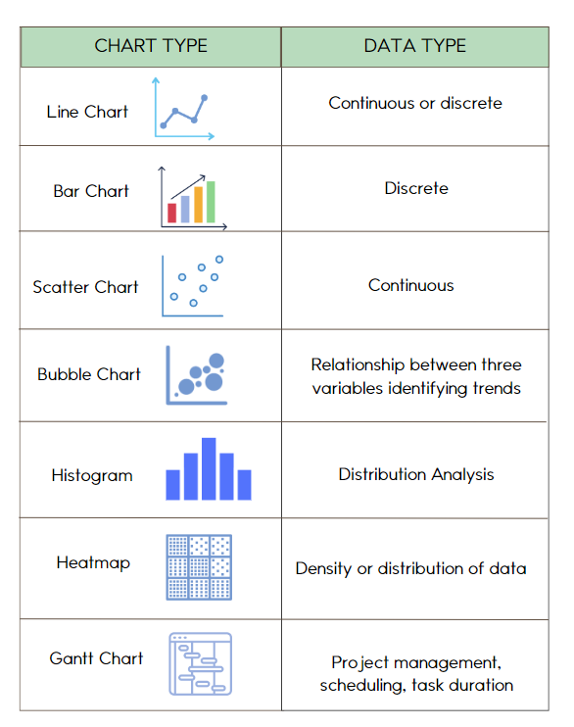
Choosing the Right Chart Type
Based on:
Type of data (categorical, numerical, time-series)
Number of variables
Relationships to be shown
DATATECH LABS.

Slide 35
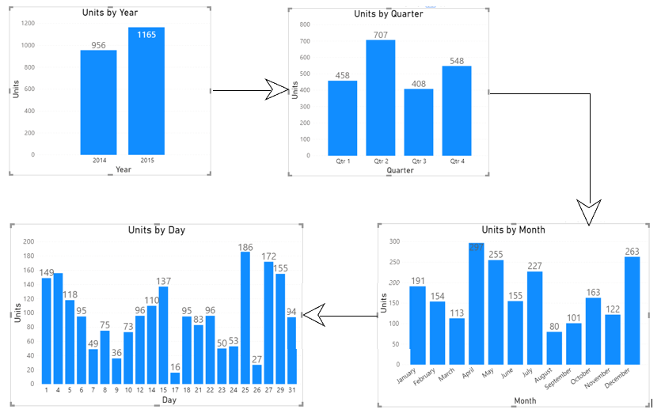
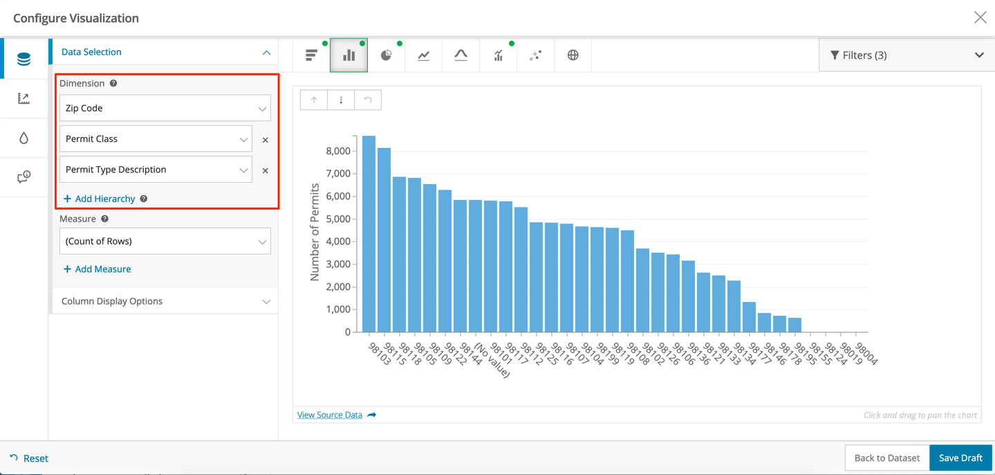
Interactivity in Data Visualization
Filtering
Drilling down
Tooltips
Zooming and panning
Linked views
Drilling down
Filtering
DATATECH LABS.

Slide 36
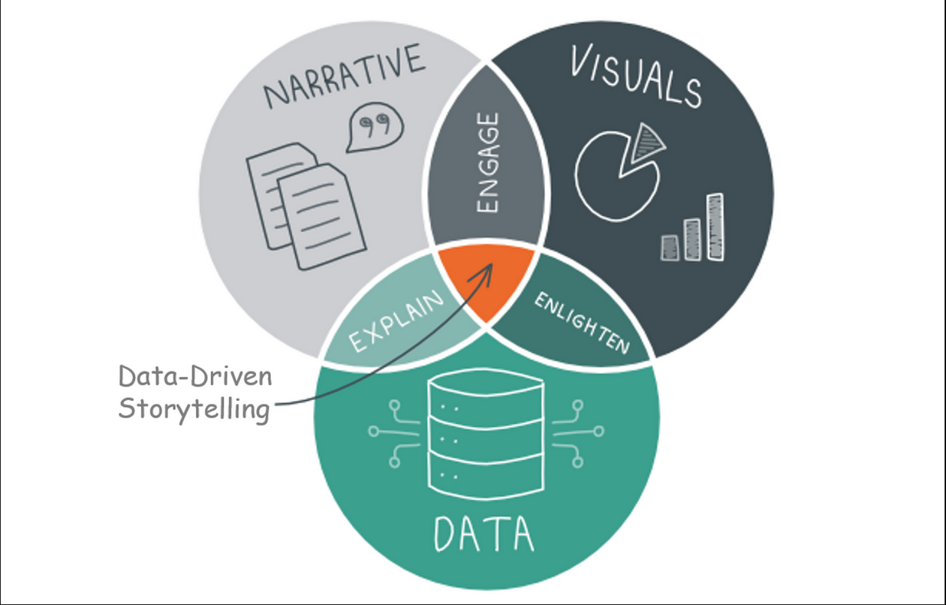
Data Storytelling
Narrative: providing the context, background, and verbally explain the chart.
Structure: Beginning, middle, end
Context: Provide background information
Focus: Highlight key insights
Visual: the chart explaining the data in a proper way related to the data nature.
Data: the data represented in the chart.
Call to action: What should the audience do with this information?
DATATECH LABS.

Slide 37
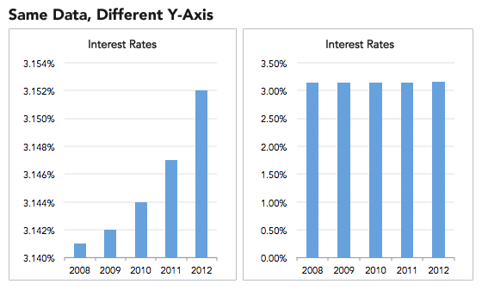
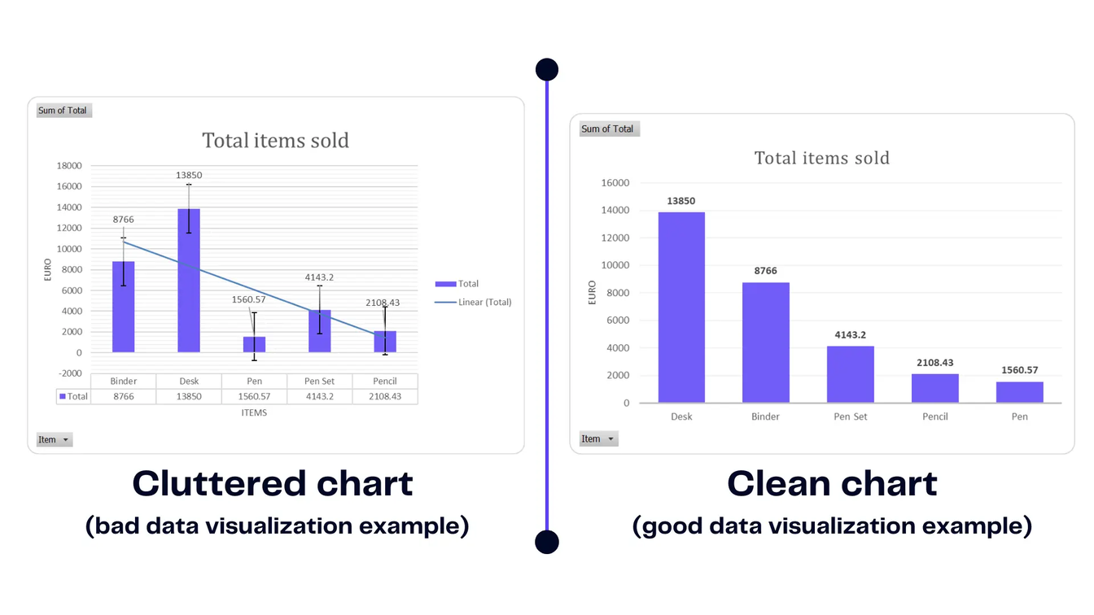
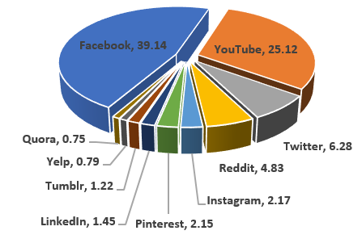
Common Pitfalls in Data Visualization
Misleading scales
3D charts
Overuse of pie charts
Cluttered designs
Ignoring context
Misleading scales
Overuse of pie charts
3D Charts
Cluttered designs
DATATECH LABS.

Slide 38
Data Visualization Tools:
Power BI & Superset
DATATECH LABS.

Slide 39

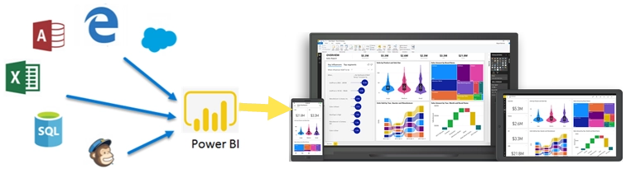
Introduction to Power BI
Definition: Microsoft's business analytics tool for interactive visualizations
Key features:
Integration with Microsoft ecosystem
Power Query for data transformation
DAX (Data Analysis Expressions) for calculations
AI-powered insights
DATATECH LABS.

Slide 40
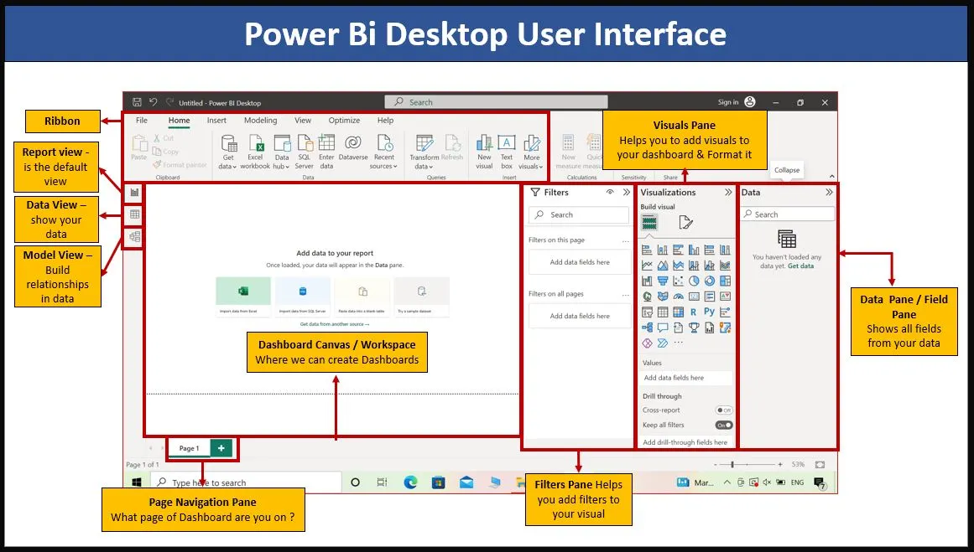
Power BI Interface
Report view
Data view
Model view
Fields pane
Visualizations pane
DATATECH LABS.

Slide 41
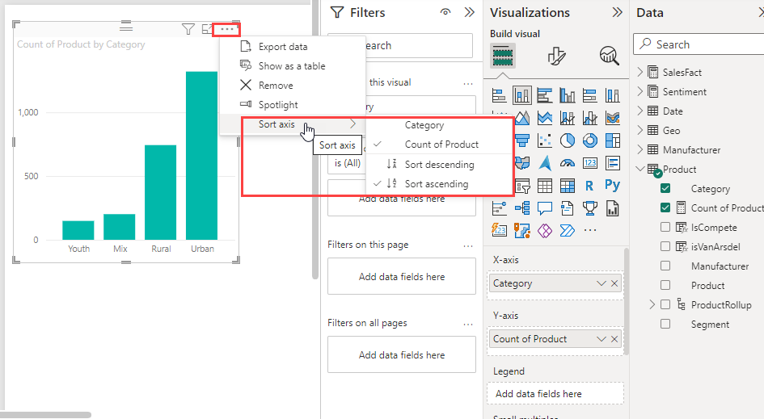
Creating Visualizations in Power BI
Importing and connecting to data
Creating measures and calculated columns
Building basic charts
Applying filters and slicers
Formatting and customizing visualizations
DATATECH LABS.

Slide 42
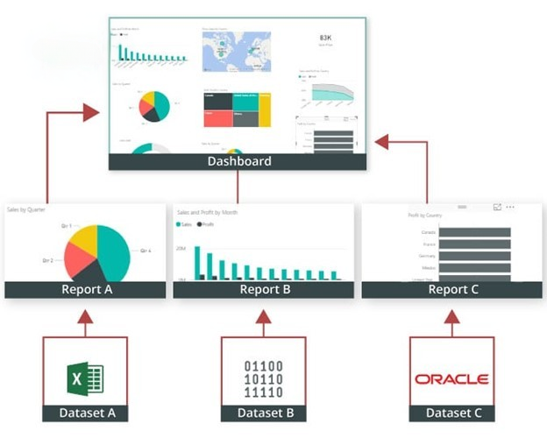
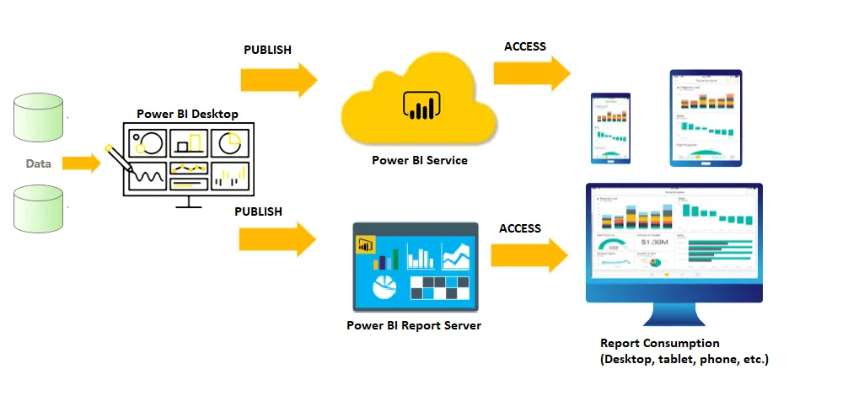

Power BI Dashboards and Reports
Difference between dashboards and reports
Creating and customizing dashboards
Sharing and collaboration features
Power BI Desktop vs. service (Power BI Online)
DATATECH LABS.

Slide 43

Introduction to Apache Superset
Overview:
Apache Superset is an open-source data visualization and exploration platform.
It enables users to create and share interactive dashboards and reports directly from various data sources.
Key Features:
Data Exploration: Query and visualize data with a user-friendly interface.
Interactive Dashboards: Build and share dashboards with various types of visualizations.
Open-Source and Extensible: Easily customizable and extensible to fit various needs.
DATATECH LABS.

Slide 44
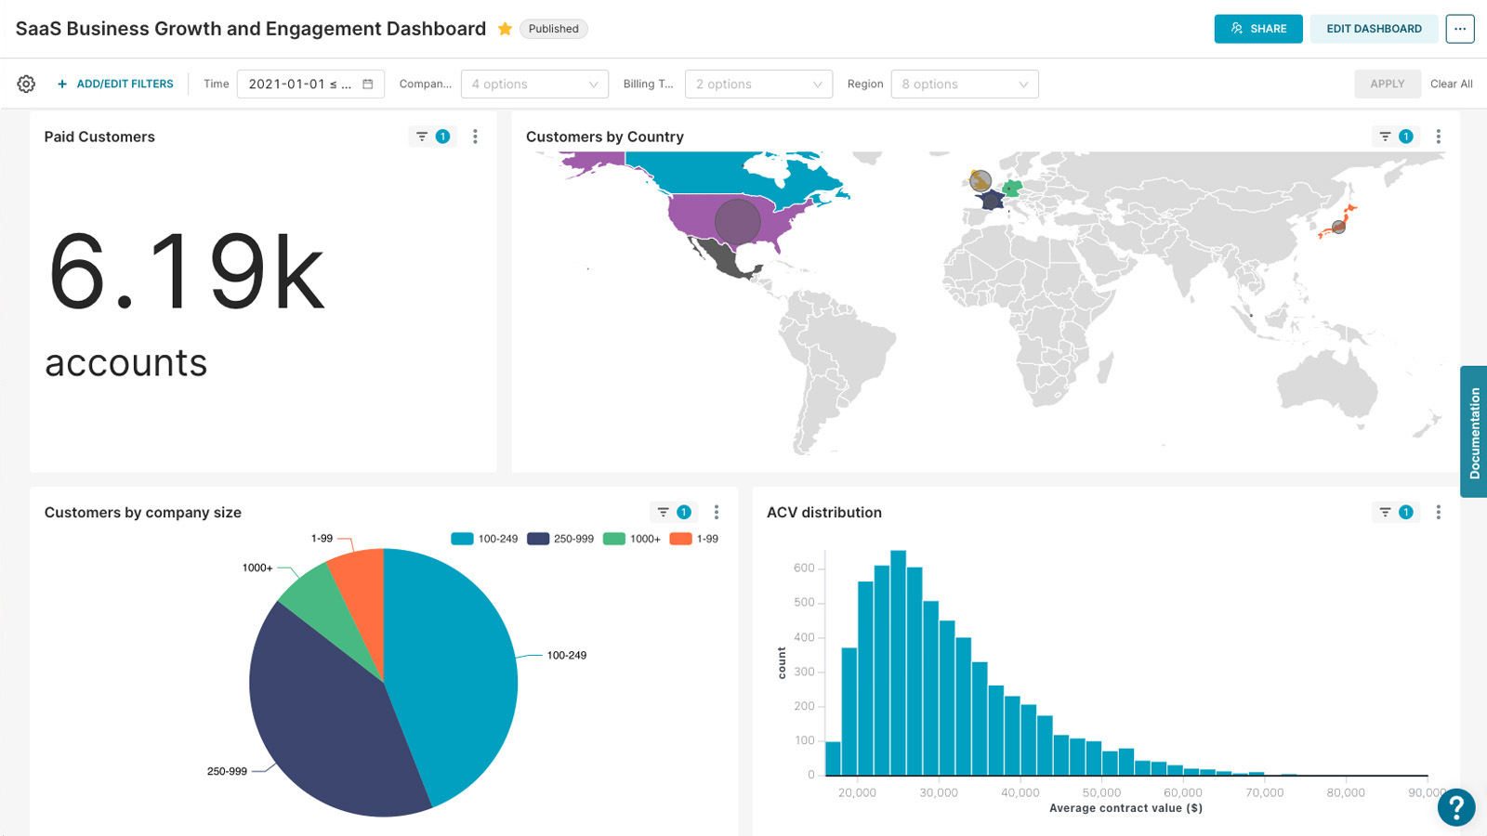
Introduction to Apache Superset
DATATECH LABS.

Slide 45
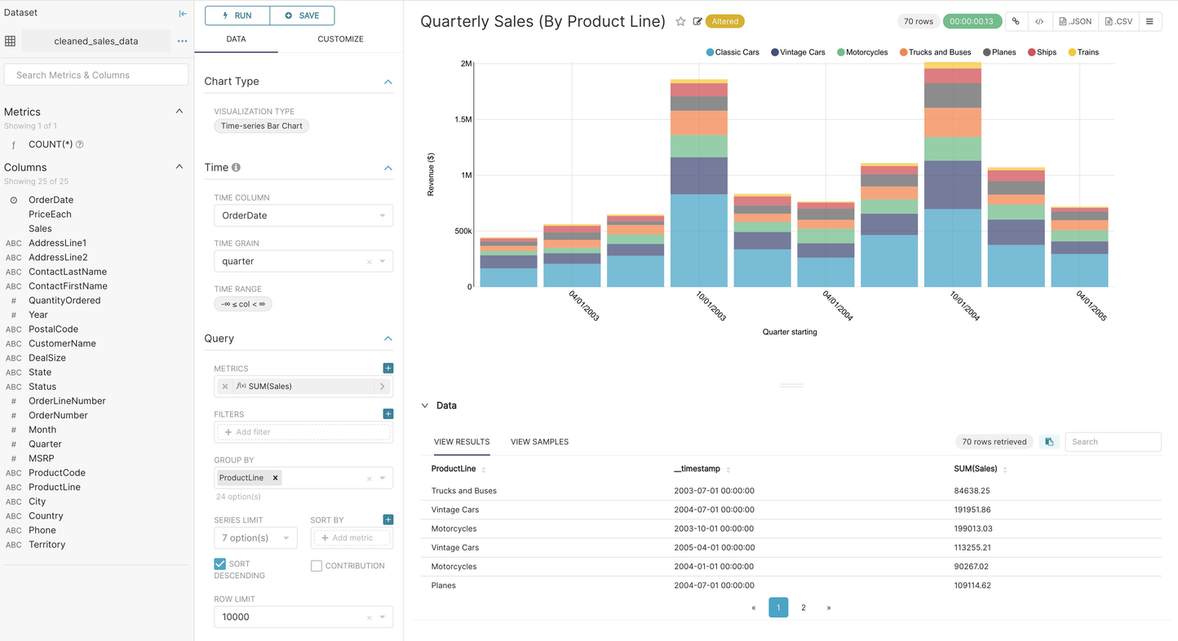
Key Components of Apache Superset
SQL Lab: A built-in SQL editor for querying data directly from connected data sources.
Chart Builder: An intuitive interface to create different types of charts like bar, line, pie, scatter, etc.
Dashboard: A space to combine multiple charts and data elements into a cohesive, interactive dashboard.
Data Connectivity: Supports a wide range of
data sources such as SQL databases,
cloud data warehouses, and more.
DATATECH LABS.

Slide 46
Benefits of Using Apache Superset
Easy Integration: Connects with multiple data sources, including SQL databases, NoSQL stores, and cloud data warehouses.
User-Friendly: No need for advanced programming skills; drag-and-drop interfaces and pre-built visualization templates make it accessible to a wide range of users.
Real-Time Analytics: Provides the ability to visualize data in real-time, supporting decision-making processes.
Scalability and Performance: Optimized for handling large datasets, making it suitable for big data environments.
DATATECH LABS.

Slide 47
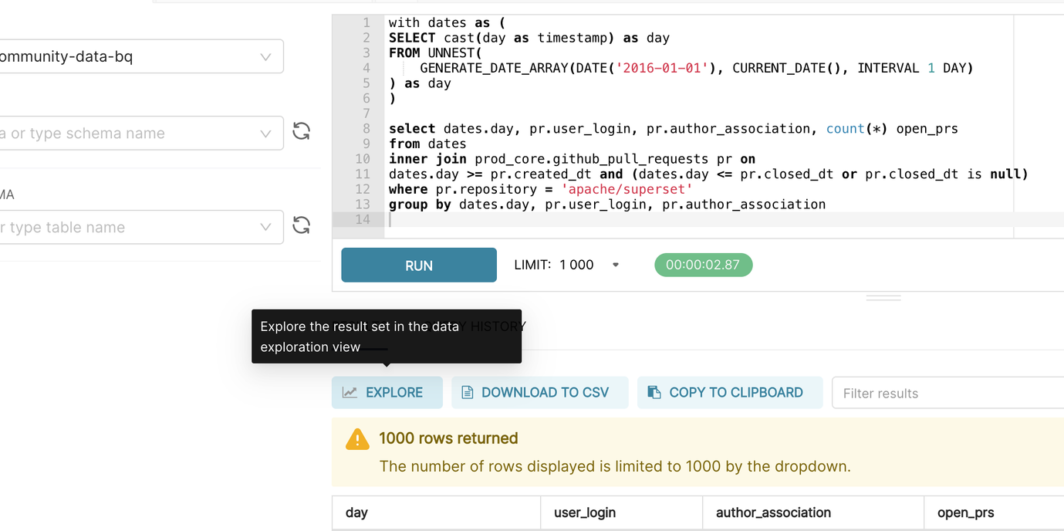
Superset Example Use Cases
Business Intelligence (BI): Create interactive dashboards for monitoring KPIs and business metrics.
Data Exploration: Allow data scientists and analysts to explore data directly from connected sources.
Reporting: Automate and distribute
reports to stakeholders on a scheduled
basis.
Data Exploration
DATATECH LABS.

Slide 48
Hands-on:
Exploring BI Tools:
Power BI
Apache Superset
DATATECH LABS.

Slide 49
Q&A and Discussion
DATATECH LABS.

Slide 50

MEET OUR TEAM
Omar AlSaghier
Sr. Data Engineer
DATATECH LABS.

Slide 51







DATATECH LABS.
THANK YOU
OUR CONTACT
DataTechLabs
datatechlabs.ai@gmail.com
datatechlabs.ai
Amman, Jordan

